Slide 1
Lily Agent
Terrence Wang 3/30/2025
One-Click Lead Generation & Outreach

Slide 2
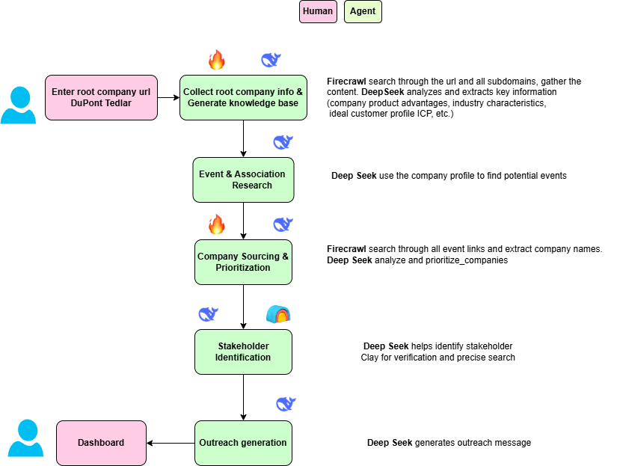
AI Agent
workflow

Slide 3
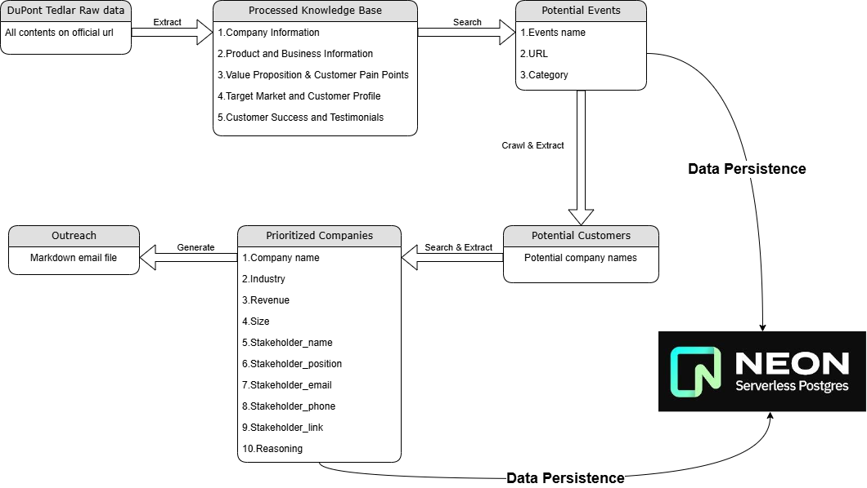
Data
Flow

Slide 4
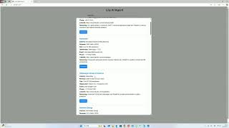
Implementation result
One minute demo video:
https://www.youtube.com/watch?v=zpdn_4kstuM

